Slide 1
Vanessa Latchem-Smith’s
SQL project for CodeFirstGirls:
LegalFirm

Slide 2
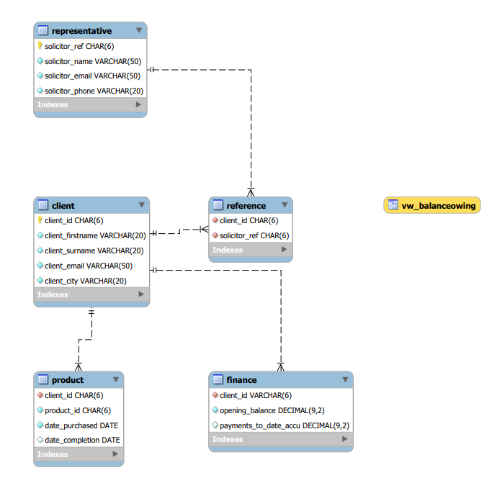
Database Tables
Clients will
Finance legal
Products which are serviced by
Legal Representatives

Slide 3
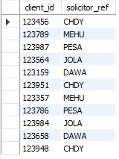
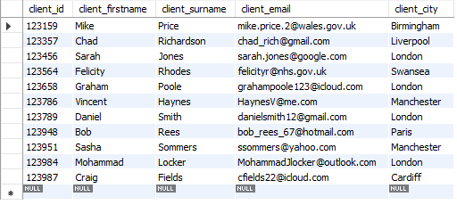
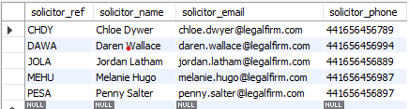
Tables are linked via Client ID and Solicitor Reference

Slide 4

Imagine we want to find out how many clients associated with a specific solicitor has more than £1000 on account
Using a JOIN and HAVING query:
SELECT c.client_id, c.client_firstname, c.client_surname, (f.opening_balance - f.payments_to_date_accu) as money_on_account
FROM client as c
JOIN finance as f
ON c.client_id = f.client_id
HAVING money_on_account >1000;
We can see that Chloe Dwyer has one client that has a large sum of amount of money on account, ready for her to start billing

Slide 5
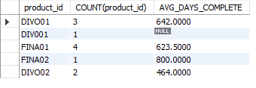
How long does each legal product take to complete?
Using a STORED FUNCTION and GROUP BY query:
SELECT product_id, COUNT(product_id), AVG(DATEDIFF(date_completion,date_purchased)) AS AVG_DAYS_COMPLETE
FROM product
GROUP BY product_id;
We can see how long each service takes to complete, on average:
This is good for reporting, targets, and marketing

Slide 6

Now we want to know which solicitors have clients that are in debt to the company:
Using a SUBQUERY to extract the client ID linked to the solicitor reference:
SELECT solicitor_ref, client_id
FROM reference
WHERE client_id in
(SELECT client_id FROM finance
WHERE (opening_balance - payments_to_date_accu)<0);
We can see two solicitors have two clients with negative balances:
Useful for accounts team to send invoices

Slide 7
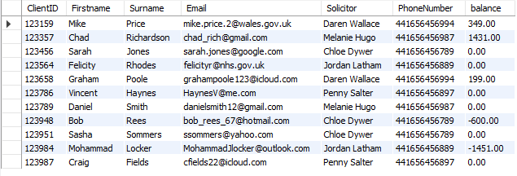
We want to know the current balance for each client, along with their contact information and that of their solicitor :
Using JOIN on four of the five tables:
SELECT c.client_id as ClientID, c.client_firstname as Firstname, c.client_surname as Surname, c.client_email as Email, r.solicitor_name as Solicitor, r.solicitor_phone as PhoneNumber, (f.opening_balance - payments_to_date_accu) as balance
FROM client as c
LEFT JOIN finance as f
ON c.client_id = f.client_id
LEFT JOIN reference as ref
ON c.client_id = ref.client_id
LEFT JOIN representative as r
ON ref.solicitor_ref = r.solicitor_ref;
We now have a list that can be used to generate emails to the clients to say
“Hey CLIENT, this is your solicitor and their number, if you want to get in touch. By the way, your balance is £xx”

Slide 8
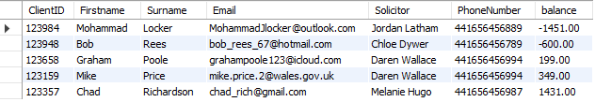
Building on this, we can narrow down the data for the accounts team to be able to contact the client:
Specifying that the balance must be above OR below 0 and adding and ORDER BY:
SELECT c.client_id as ClientID, c.client_firstname as Firstname, c.client_surname as Surname, c.client_email as Email, r.solicitor_name as Solicitor, r.solicitor_phone as PhoneNumber, (f.opening_balance - payments_to_date_accu) as balance
FROM client as c
LEFT JOIN finance as f
ON c.client_id = f.client_id
LEFT JOIN reference as ref
ON c.client_id = ref.client_id
LEFT JOIN representative as r
ON ref.solicitor_ref = r.solicitor_ref
WHERE (f.opening_balance - payments_to_date_accu) <0 OR (f.opening_balance - payments_to_date_accu) >0
ORDER BY balance;
Now we can see that legalfirm have a few clients who need to make a payment, and some who have excess money that may need refunding:

Slide 9

Adding a VIEW for the accounts team to chase the clients with debt:
Using VIEW and JOIN on two base tables:
CREATE OR REPLACE VIEW vw_BalanceOwing AS
SELECT c.client_id, (f.opening_balance - payments_to_date_accu) as BalanceOwing
FROM client as c
LEFT JOIN finance as f
ON c.client_id = f.client_id
WHERE (f.opening_balance - payments_to_date_accu) <0;
Ordering the results creates a list of the largest debts down to the smallest:

Slide 10

Adding a PROCEDURE to show all the clients to a particular solicitor where money is owing:
Using JOIN on the base tables and asking for the four character reference of the solicitor:
DELIMITER //CREATE PROCEDURE ClientPerSolicitorWBalance (IN solicitorinitials CHAR(4))
BEGIN
SELECT c.client_id as ClientID, r.solicitor_name as Solicitor, (f.opening_balance - payments_to_date_accu) as balance
FROM client as c LEFT JOIN finance as f ON c.client_id = f.client_id
LEFT JOIN reference as ref ON c.client_id = ref.client_id
LEFT JOIN representative as r ON ref.solicitor_ref = r.solicitor_ref
WHERE (f.opening_balance - payments_to_date_accu) <0 ANDref.solicitor_ref = solicitorinitials;
END //
DELIMITER ;
I can then call the procedure and specify the solicitor as CHDY:
CALL ClientPerSolicitorWBalance ('CHDY’);
Useful in user dashboards for the solicitors to see which clients need chasing before more work is done, and for accounts to chase, and for reporting of KPIs.

Slide 11
POSSIBILITIES FOR EXPANSION
Adding tables to hold data about client communication preferences; payment preferences; payment history; -- linked clients IDs (where a person has more than one account).--
Adding incremental automation to the client IDs for new clients
Creating procedures to send welcome email with solicitor details to clients when they are entered into the system

Slide 12
ERRORS ALONG THE WAY
To start, there was not enough table data.
The tables are not normalised (client table holds data on email address and phone number and city – these should be separate tables)
Column names are bulky, maybe have a simpler column naming structure.
Not knowing how to remove NULL data distracts the results.

